Slide 1
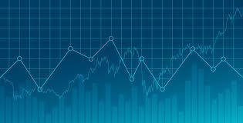
Simulating the Stock Market with an Irrational Agent-Based Model
Alex Chang

Slide 2
Abstract
Behavioral economics is a continuously developing field of economics. One useful behavioral model is the agent-based model (ABM), which models agents and their interactions. ABMs can be used for a variety of applications, including financial modeling. Previous efforts to use ABMs for modeling the stock market have assumed that human decision making is entirely rational. However, human behavior is impacted by many irrational factors, such as flight or fight, which is what my model hopes to account for. By taking into account irrational parameters, such as risk tolerance, optimism, and sentimentality, a more accurate could be developed. Each agent uses a mix of irrational and rational decision making to determine whether to buy, sell, or hold a stock. These buy and sell orders are then sent to the market, which seeks to fulfill them as realistically as possible. The price of the stock evolves organically from the discrepancy between demand and supply. By comparing the performance of the model against real-world stocks, such as the S&P 500, the value of the model for financial forecasting will be determined.

Slide 3
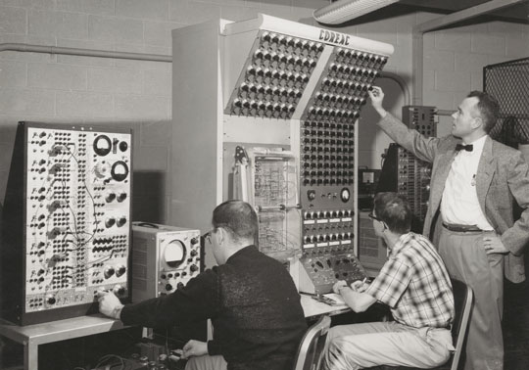
A Brief History of Economics
The Wealth of Nations, Adam Smith (1776)
Efficient Market Hypothesis (1900)
Computation revolution (1960s)

Slide 4
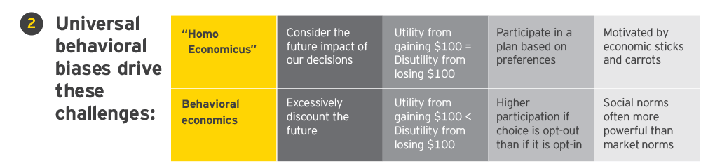
Modern Economics
Prospect Theory: An Analysis of Decision Under Risk (1979)
Richard Thaler wins Nobel Prize (2017)
Neuroeconomics [1]

Slide 5

Agent-Based Modeling (ABM)
Santa Fe Artificial Stock Market (2002) [2]
Experience based reinforcement learning, Brock, Hommes, and Wagener (2009) [3]

Slide 6
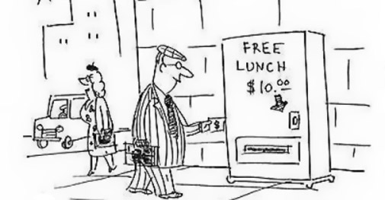
Developing a new model
To make ABMs more accurate for financial modeling, irrational (emotional) factors will be taken into account when determining agent behavior.
These factors will include personality traits such as risk tolerance, contrarianism, adaptability, optimism, reactionism, etc

Slide 7
Project Roadmap
The model is being implemented in Java, based on the mechanics of the Santa Fe Artificial Stock Market.
Initial Conditions
The Model
Final Conditions
Stock Price
Buy Orders
Stock Price
Agent Population
Market
Trading Volume
Sell Orders
Previous Performance
Trading Volume

Slide 8
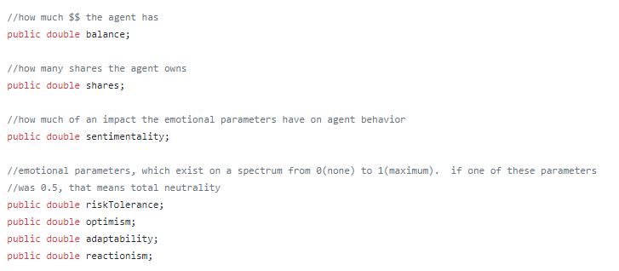
Agent Implementation (agent.java)

Slide 9
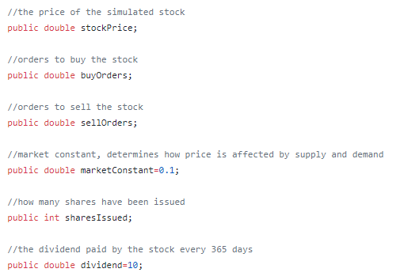
Market Implementation (market.java)

Slide 10
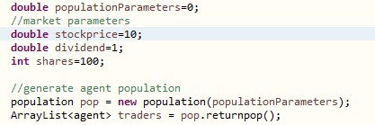
World Implementation (world.java)
Agent.java
Market.java
World.java

Slide 11
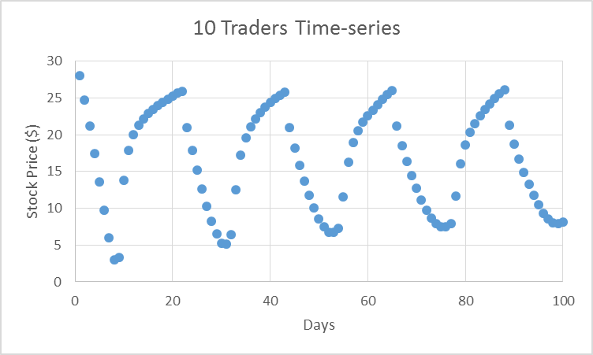
Example

Slide 12
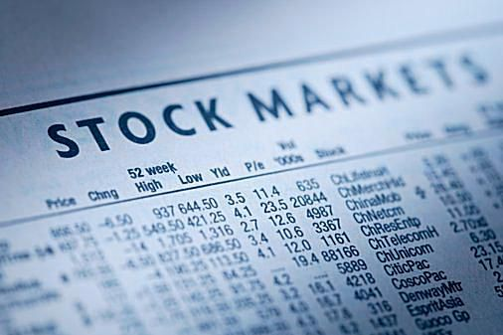
Next Steps
Modify agents to adapt. Generate different agent populations, and compare model performance with real stocks.

Slide 13
References
[1] Glimcher, Paul W., and Ernst Fehr. “Introduction: A Brief History of Neuroeconomics.” 20 Aug. 2015, nyuscholars.nyu.edu/en/publications/introduction-a-brief-history-of-neuroeconomics-2.
[2] Ehrentreich, Norman. “The Santa Fe Artificial Stock Market Re-Examined - Suggested Corrections.” SSRN Electronic Journal, 2002, doi:10.2139/ssrn.329780.
[3] Brock, William A., et al. “More Hedging Instruments May Destabilize Markets.” SSRN Electronic Journal, 2008, doi:10.2139/ssrn.933043.

